Slide 1
IBM API Connect Overview and HCaaS API Implementation
By: Memar Demeke
Date: 09/03/2020

Slide 2
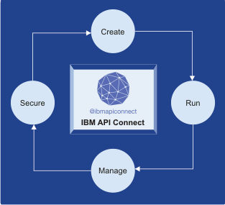
IBM API Connect Overview
IBM API Connect is a simplified, and comprehensive API Management solution that focuses on all stages of an API lifecycle.
API Management is the process of creating and publishing web APIs, enforcing their usage policies, controlling access, nurturing the subscriber community, collecting and analyzing usage statistics, and reporting on performance in between various software components.
The steps of the API lifecycle include:-
1. Creating API 2. Running API 3. Managing API 4. Securing API

Slide 3
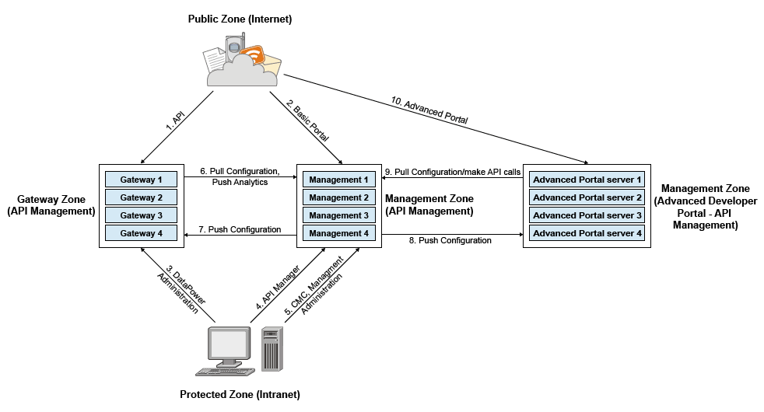
Components of IBM API Connect

Slide 4
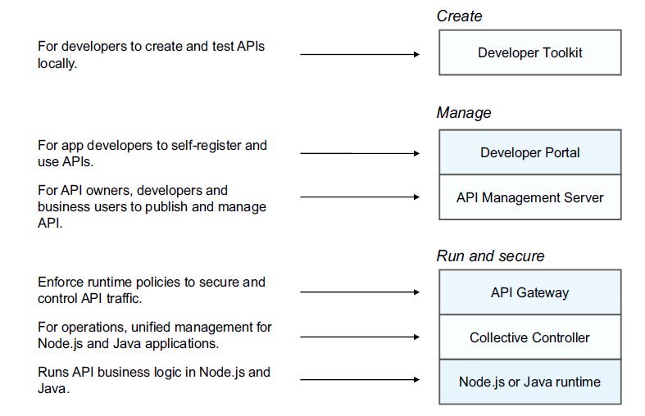
Components of IBM API Connect

Slide 5
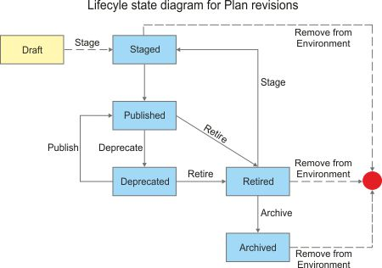
API Lifecycle

Slide 6

Packaging an API
Seen at the developer Portal
An API is a business functionality that is exposed as web service.
A Plan is a set of APIs. Application developers gain access to APIs by registering applications to access Plans. Policy settings, like limiting usage of APIs are specified on Plan level. You can also specify single quota policy at plan level and it is applicable to all APIs included in the plan.
A Product is a set of Plans. It is higher level abstraction, that is exposed on developer portal.
Product
Plan
API
Registers for
Consumes

Slide 7
API Connect Capabilities
API Connect (APIC) is an API management solution that addresses critical aspects of the API lifecycle providing the capability to create, run, manage and secure APIs and microservices. It can be used to create high-quality, scalable and secure APIs for application servers, enterprise service buses (ESB), databases, and mainframes (z/OS Connect).
Lightweight design-time governance for API registration
Visibility
Runtime Integration
Manage consumer-provider relationships
Lifecycle Management
Discover APIs, even across lines of business, i.e. with a public and private API catalog
Additional Features
API Analytics
Support for any type of documentation (including OLAs, SLAs, and ICDs)
Administrators can manage security and governance over APIs
API Versioning
Runtime governance (rate limiting and quota management)
Developer Portal
Operations Automation

Slide 8

APIC Capabilities
API Lifecycle Management Automated creation of new APIs in minutes.
Secure API’s Securely exposing enterprise services via APIs to new mobile, IoT, and web applications.
Visual Coding Options Automated, visual, and coding options that API providers can use to create scalable APIs
Built-In Policies Built-in policies like Gateway script , Javascript , Json to XML , XML to JSON , Generate JWT , Validate JWT , redaction policy etc
Developer Portals Customizable, self service portals for publishing APIs for discovery and use.
Analytics API usage analytics for both API providers and consumers, with runtime and historical reporting on usage patterns and performance metrics.
Monetization Set pricing details in plans to define revenue-producing subscription plans for your APIs

Slide 9
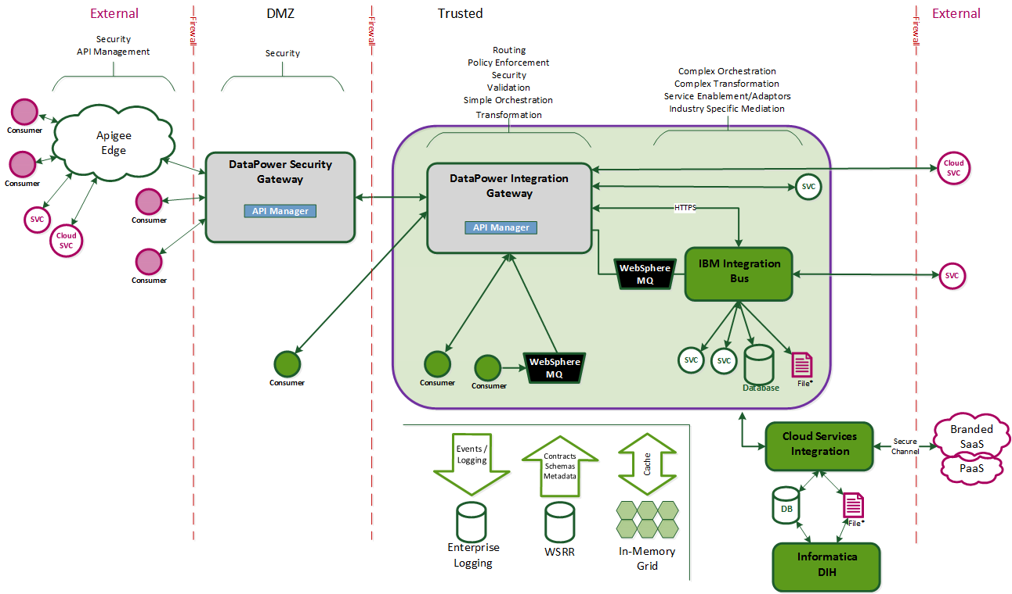
Where It Fits

Slide 10
When to use APIC
REST API’S:
All lightweight REST API’s which deal with <= 4MB * payloads . Basically real time transactions with the <=4MB limit can go through APIC ( if the interface deals with batch transfers, it needs to be built on Datapower).
Proxy to Datapower services :
Can be built as a proxy to existing/new Datapower services which deal with less than 4MB* payloads
When to use Datapower over APIC:
Payloads > 4MB:
All services which deal with > 4MB payloads
MQ Integration:
Services which need MQ integration
IIB Integration:
Services which need IIB integration
SLM
Services which need SLM shaping
* 4MB threshold used initially but may be increased during API Prove phase as we “test and learn” payload limits

Slide 11
Selected REST APIs built on API Connect
Product Name | API | Operation | URL | Env’t | Space | APP
CAS Provider Contract | ProviderContract | GET |  | DEV | Claim | TestApp_HCaaS
 |  | GET
CAS Provider Selection | ProviderSelection | POST/providerSelection
CAS Group Policy | GroupPolicy | POST/group-policy
 |  | GET/group-policy
 |  | PATCH/group-policy
CAS Provider | CASProviderDemographics

